Slide 1
Assessment of marginal workers in tamilnadu-a socioeconomic analysis
ADS_PHASE2

Slide 2
Contents
Marginal workers
Types of marginal workers
Dataset
Python-numpy & pandas
Logistic regression
Rest of the explanation

Slide 3


Slide 4
Marginal workers
A marginal worker is typically defined as a person who is engaged in irregular or occasional employment, or who works for a limited number of hours per day or days per week. This term is often used in the context of labour statistics and economic analysis to distinguish individuals who have less stable or consistent employment compared to regular or full-time workers. Marginal workers may include part-time employees, casual labourers, seasonal workers, or those who work intermittently. The concept of marginal workers is important for understanding labour market dynamics and socioeconomic conditions.

Slide 5
Types of marginal workers
Agricultural marginal workers
Non-agricultural workers
Casual labourers
Part time workers
Seasonal workers
Unemployed workers
Unskilled workers
Informal sector workers
Migrant workers

Slide 6
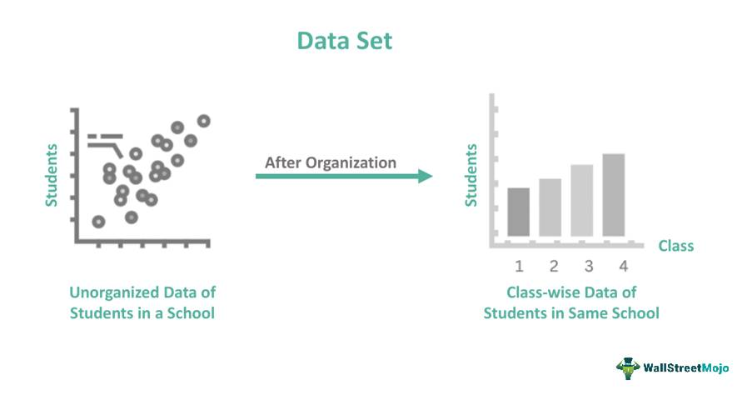
Dataset used:
Kaggle is one of the largest communities of data scientists and machine learning practitioners in the world, and its platform hosts thousands of datasets covering a wide range of topics and industries.
https://tn.data.gov.in/catalog/marginal-workers-classified-age-industrial-category-and-sex-census-2011-india-and-states
Above link is the dataset which is used for phase2

Slide 7
Python-numpy&pandas
Python: Python has in-built mathematical libraries and functions, making it easier to calculate mathematical problems and to perform data analysis.
Numpy: NumPy is commonly used within data science in order to work through numerical analyses and functions, such as creating and working with arrays, returning descriptive statistics, and a variety of machine learning models and mathematical formulas.
Pandas: Pandas allows us to analyze big data and make conclusions based on statistical theories. Pandas can clean messy data sets, and make them readable and relevant.

Slide 8
Logistic regression
Logistic regression aims to solve classification problems. It does this by predicting categorical outcomes, unlike linear regression that predicts a continuous outcome.
Imported libraries:
from sklearn .linear model import LinearRegression
from sklearn.metrics import mean_squared_error
from sklearn.model_selection import train_test_split

Slide 9
Rest of the content
1.Import libraries
2.Load data(i.e., ‘pd.read_csv()’)
3.Preprocessing the data(i.e., to handling missing data,drop the unused column,rows etc.,)
4.Split the data(i.e., train_test_split())
5.Train the model(i.e., ‘X_train’ and ‘Y_train’)
6.Test the model(i.e., X_test)
7.Evaluate model performance(i.e., accuracy,precision,etc.,)

